Slide 1



Learn. Imagine. Build. .NET Conf
.Net <3 Azure
Riccardo Cappello
https://about.me/rcappello
@rcappello

Slide 2
The evolution of application platforms
On-Premises
IaaS
PaaS
Serverless

Slide 3
Before cloud
What is the right size of
servers for my business needs?
What happens in case of
server hardware failure?
How do I deploy new code to my server?
Which packages should
be on my server?
How can I increase server utilization?
What media should I
use to keep backup?
How can I scale my app?
What size of servers
should I buy?
Who monitors
my App?
How often should I backup my server?
Who monitors
my Servers?
What storage I need to use?
Which OS should I use?
Who has physical
access to my servers?
Are my server in a
secure location?
Do I need secondary
network connection?
How many servers
do I need?
Do I need a UPS?
What happens if the
power goes out?
How often should
I patch my servers?
How can I dynamically
configure my app?
It takes how long to provision a new server?

Slide 4
Then came IaaS—table stakes for digital business
What is the right size of servers for my business needs?
How can I increase server utilization?
How many servers do I need?
How can I scale my app?
How often should I patch my servers?
How do I deploy new code to my server?
How often should I backup my server?
Which OS should I use?
Which packages should be on my server?
Who monitors my App?

Slide 5
Then PaaS, critical for digital transformation
What is the right size of “servers” for my business needs?
How can I increase “server” utilization?
How many “servers” do I need?
How can I scale my app?

Slide 6





Industry-leading Application PaaS Platform
SOLUTIONS
Transactional
Apps
Digital
Marketing
LoB App
Modernization
SERVICES
Web Apps
Web App for Containers
API Apps
Mobile Apps
IDE
Enterprise Integration
Serverless compute
Data /Storage
Intelligence
Application Insights
PLATFORM
App Service
Fully Managed Platform • High Productivity Development • Enterprise Grade Apps

Slide 7

Azure App Service
Enterprise-grade apps
Fully managed platform
High productivity development
Global data center footprint
Hybrid support
Built-in auto scale and load balancing
High availability with auto-patching
.NET, Java, PHP, Node,
Ruby, and Python
Staging and deployment
AAD integrated
Secure + compliant
Reduced operations costs
Backup and recovery
Testing in production
App gallery marketplace

Slide 8
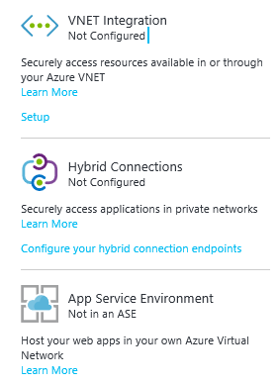
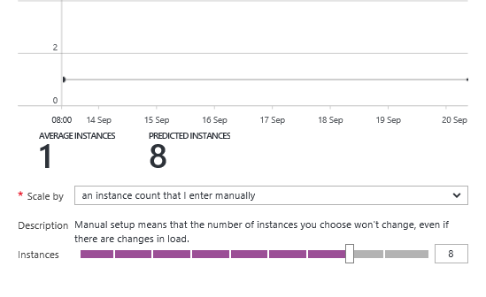
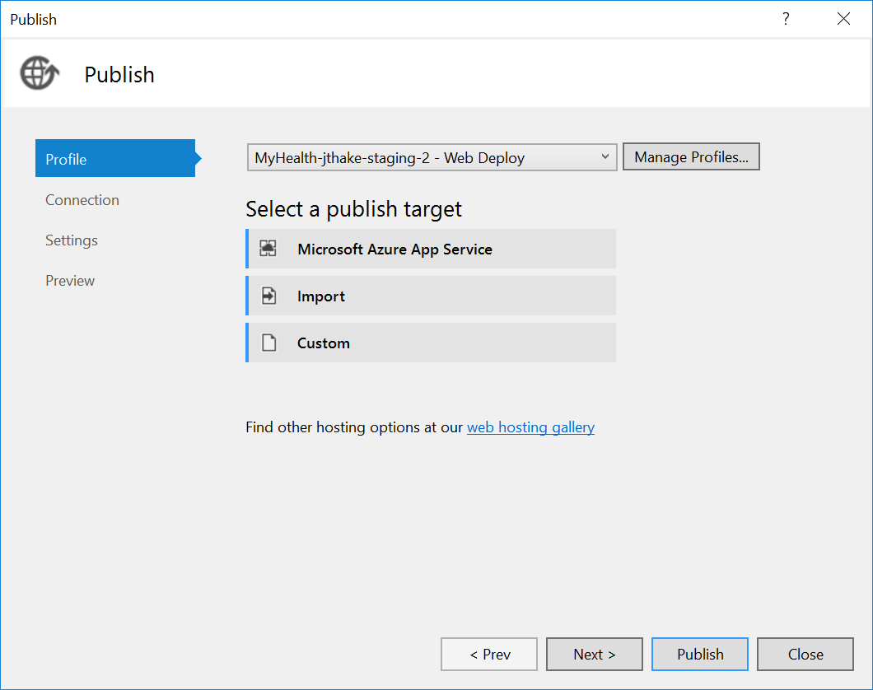
A seamless developer experience
Enterprise-grade apps
Fully managed platform
High productivity development

Slide 9

App Service
From on-premises to the cloud
AZURE APP SERVICE (MULTI-TENANT)
Get your Web, API, or Mobile App created in seconds in the cloud. We provide the infrastructure, you provide your application code.
APP SERVICE ENVIRONMENT
Run your apps in virtual network at high scale. Manage all of the resources behind your public endpoint creating an isolated environment specifically for your organization.
AZURE STACK*
Leverage cloud innovations in on-premises infrastructure. App Service on Azure Stack brings the power of Azure App Service to your own data centers.
Notes:
*App Service on Azure Stack is in Preview as of July 2017.

Slide 10
Containers
Virtual Machines
App
App
App
Libraries
Libraries
Libraries
Containers
Guest OS
Guest OS
Guest OS
App
App
App
Libraries
Libraries
Libraries
Hypervisor
Container Engine
Host Operating System
Operating System
Lightweight alternative to virtual machines
Smaller, less expensive, faster to start up, and self-contained
Notes:
A virtual machine is -- well -- a virtualized machine created and managed by a hypervisor such as VirtualBox or Hyper-V. Even though a VM runs on a machine that has an operating system, each VM requires its own complete operating system, even if it's the same operating system as the host OS. VMs offer a very high degree of isolation, but at a cost: longer startup times, lower portability (ever tried to move a 127 GB virtual hard disk, or VHD, from one PC to another?), and higher memory requirements. Containers, by contrast, leverage the operating system that is already in place but offer nearly as much separation. RAM requirements are lower since the OS isn't being duplicated in each container, and cost is lower, too, because while cloud platforms typically charge for each VM, a single VM can host multiple container instances.

Slide 11
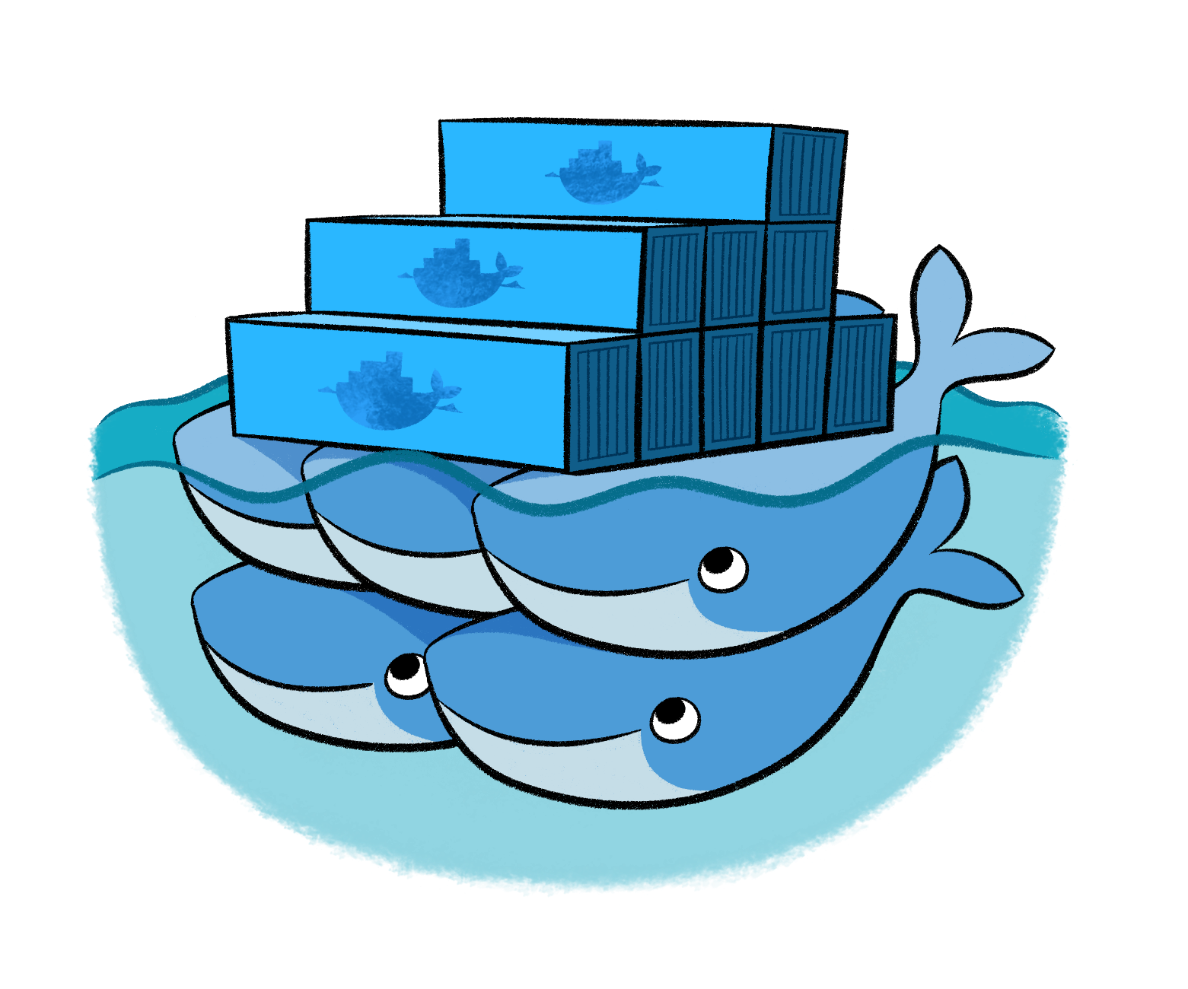
Docker
Leading open-source containerization platform
Supported natively in Azure
Docker containers wrap up a piece of software in a complete filesystem that contains everything it needs to run: code, runtime, system tools, system libraries – anything you can install on a server. This guarantees that it will always run the same, regardless of the environment it is running in
Notes:
Docker (www.docker.com) isn't the world's only containerization platform, but it is the most popular. It is free, open-source, and Linux-based, with Windows support (Windows Server 2016) in the works. It has earned massive mindshare in the developer community. And with Azure Container Service, you can deploy Docker containers to Azure with minimal effort. Moreover, Docker containers are easily moved between Azure and Amazon Web Services (AWS), affording developers portability between cloud platforms.

Slide 12
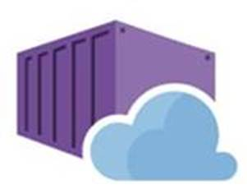

Web app for containers
High productivity development
Fully managed platform
Enterprise-grade apps
Deployment
with ease
CI/CD build
and deploy
Built-in auto scale and load balancing
High availability with auto-patching
Global data center footprint
Private registry
support
Testing in production
Staged deployment
with slots
Monitoring
and diagnosis
Backup and recovery
AAD integrated
Secure + compliant

Slide 13
Demo:
App Service

Slide 14
What is Serverless?
$
Abstraction of servers
Event-driven
Micro-billing

Slide 15
Benefits of Serverless
Automatically Scale
Focus on business logic
Faster time to market

Slide 16

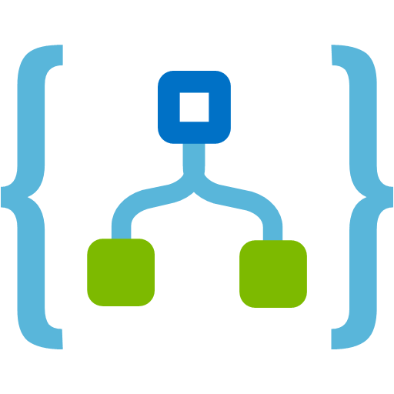

Serverless Components in Azure
Functions
Logic Apps
Event Grid
Serverless Compute
Serverless Workflow
Serverless Events

Slide 17


Introducing Azure Functions
Code
Azure Functions
Events + data
Notes:
Azure Stack
Open source

Slide 18
Triggers and Bindings
Type | Service | Trigger | Input | Output
Schedule | Azure Functions | ü
HTTP | Azure Functions | ü |  | ü
Blob Storage | Azure Storage | ü | ü | ü
Events | Azure Event Hubs | ü |  | ü
Queues | Azure Storage | ü |  | ü
Queues and topics | Azure Service Bus | ü |  | ü
Storage tables | Azure Storage |  | ü | ü
No-SQL DB | Azure CosmosDB |  | ü | ü
Push notifications | Azure Notification Hubs |  |  | ü
Twilio SMS Text | Twilio |  |  | ü
SendGrid email | SendGrid |  |  | ü

Slide 19
Automatically referenced packages
These assemblies are automatically referenced:
mscorlib
System
System.Core
System.Xml
System.Net.Http
Microsoft.Azure.WebJobs
Microsoft.Azure.WebJobs.Host
Microsoft.Azure.WebJobs.Extensions
System.Web.Http
System.Net.Http.Formatting
Platform packages, use #r directly
Newtonsoft.Json
Microsoft.WindowsAzure.Storage
Microsoft.ServiceBus
Microsoft.AspNet.WebHooks.Receivers
Microsoft.AspNet.WebHooks.Common
Microsoft.Azure.NotificationHubs

Slide 20
Demo:
Azure Functions Portal

Slide 21
New Visual Studio 2017 tooling
Based on .NET class libraries
Get the full power of IntelliSense, unit testing, and local debugging
Use attributes to define triggers and bindings

Slide 22
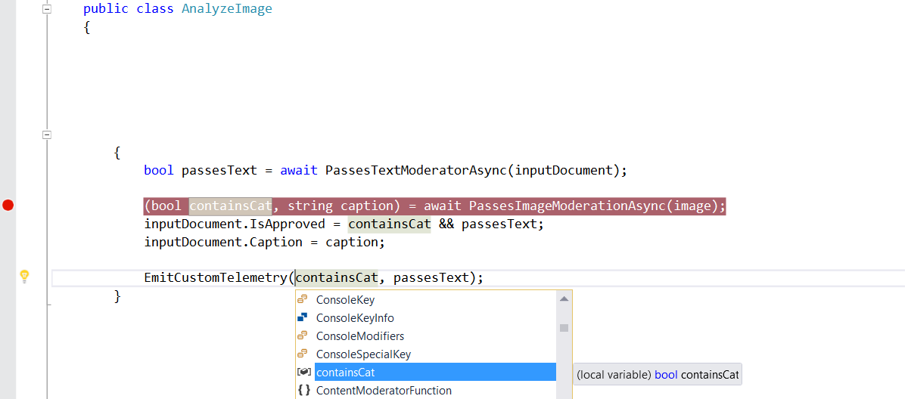
Visual Studio 2017 Tooling
/// Function entry point. Review image and text and set inputDocument.isApproved.
[FunctionName("ReviewImageAndText")]
public static async Task ReviewImageAndText(
[QueueTrigger("%queue-name%")] ReviewRequestItem queueInput,
[Blob("input-images/{BlobName}", FileAccess.Read)] Stream image,
[DocumentDB("customerReviewData", "reviews", Id = "{DocumentId}")] dynamic inputDocument)

Slide 23
Demo:
Dev+Deploy

Slide 24
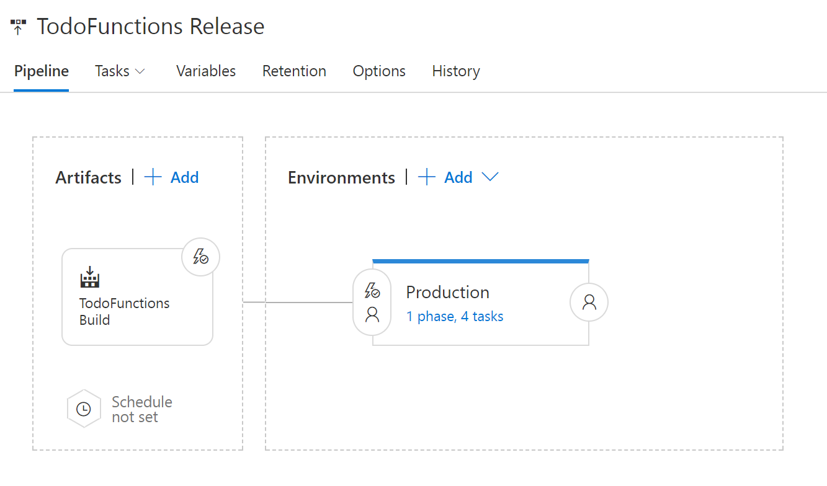
VSTS
Build and deploy with VSTS

Slide 25
Application Insights
Integrated monitoring and custom metrics with Application Insights
Write custom queries using the analytics portal
Pin graphs to portal dashboard
Notes:
Integrated Tracing
Custom metrics
App Insights NuGet Package

Slide 26
Demo:
Build & Deploy

Slide 27
Resources
Try Azure - https://azure.microsoft.com/it-it/free/free-account-faq/
Microsoft Docs – https://docs.microsoft.com
Try App Service - aka.ms/tryappservice
Azure Functions – https://functions.azure.com
Notes:
Mention Azure functions YouTube
StackOverflow
Functions is open source

Slide 28
GRAZIE!

